Slide 1
Multi Group Comparisons with Analysis of Variance (ANOVA)
BIOE
April 28th, 2016

Slide 2
Learning Objectives
What is ANOVA and when is it a useful tool?
What is the null hypothesis for ANOVA?
What are the assumptions for ANOVA?
What is a Kruskal-Wallis-Test and how is it related to ANOVA?
What is Post Hoc ANOVA Analysis?

Slide 3
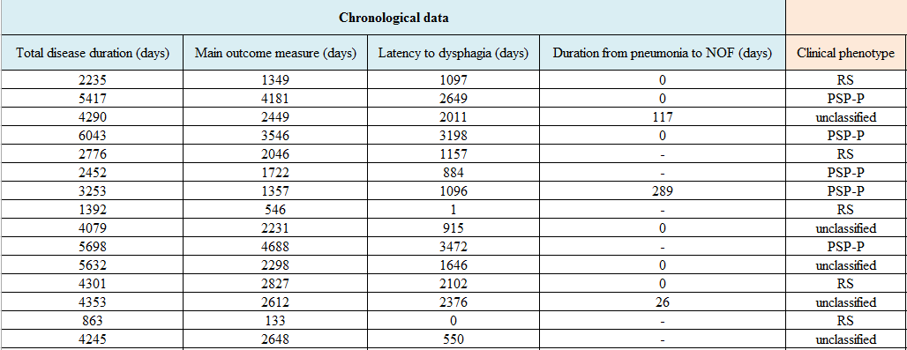
Example of desire for multi-group Comparison – Is clinical phenotype associated with disease duration?
RS = Richardson’s syndrome, PSP-P = Post Supranuclear Palsy - Parkinsonism
[1] - S. Tomita, T. Oeda, A. Umemura, M. Kohsaka, K. Park, K. Yamamoto, H. Sugiyama, C. Mori, K. Inoue, H. Fujimura, and H. Sawada, “Impact of Aspiration Pneumonia on the Clinical Course of Progressive Supranuclear Palsy: A Retrospective Cohort Study,” PLOS ONE, vol. 10, no. 8, p. e0135823, Aug. 2015.
[2] - S. Tomita, T. Oeda, A. Umemura, M. Kohsaka, K. Park, K. Yamamoto, H. Sugiyama, C. Mori, K. Inoue, H. Fujimura, and H. Sawada, “Data from: Impact of aspiration pneumonia on the clinical course of progressive supranuclear palsy: a retrospective cohort study,” 13-Aug-2015. [Online]. Available: http://datadryad.org/resource/doi:10.5061/dryad.15jj2. [Accessed: 26-Apr-2016].

Slide 4
Example of desire for multi-group Comparison – Is clinical phenotype associated with outcome?
Questions?
Q1: Are the mean values of total disease duration the same amongst the clinical phenotype groups?
Q2: Are the distributions of the total disease duration the same amongst the clinical phenotypes groups?
[1] - S. Tomita, T. Oeda, A. Umemura, M. Kohsaka, K. Park, K. Yamamoto, H. Sugiyama, C. Mori, K. Inoue, H. Fujimura, and H. Sawada, “Impact of Aspiration Pneumonia on the Clinical Course of Progressive Supranuclear Palsy: A Retrospective Cohort Study,” PLOS ONE, vol. 10, no. 8, p. e0135823, Aug. 2015.
[2] - S. Tomita, T. Oeda, A. Umemura, M. Kohsaka, K. Park, K. Yamamoto, H. Sugiyama, C. Mori, K. Inoue, H. Fujimura, and H. Sawada, “Data from: Impact of aspiration pneumonia on the clinical course of progressive supranuclear palsy: a retrospective cohort study,” 13-Aug-2015. [Online]. Available: http://datadryad.org/resource/doi:10.5061/dryad.15jj2. [Accessed: 26-Apr-2016].

Slide 5
Hypothesis Tested by ANOVA
Null Hypothesis H₀: The mean value of the members of the groups is the same
Research Hypothesis H₁ : The mean values of the members of the groups is different
Stating the Results of an ANOVA
We reject the null hypothesis with greater than 95% confidence(p < .05) that the mean values disease duration is the same amongst the groups.
We fail to reject to 95% confidence (p > .05) the null hypothesis that the mean values is the same amongst the groups.
Google: “stating results for ANOVA” – General consensus is not to be so rigorous

Slide 6
Null Hypothesis for ANOVA
H₀: The null hypothesis is that the mean value of total disease duration is the same amongst the clinical phenotype groups.

Slide 7
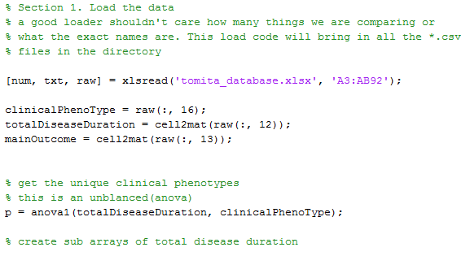
Do the clinical phenotypes have different mean disease durations?
>> p
p =
2.8410e-09
We reject the null hypothesis with greater than 95% confidence that the mean disease duration of dysphagia is the same for the clinical phenotypes.

Slide 8
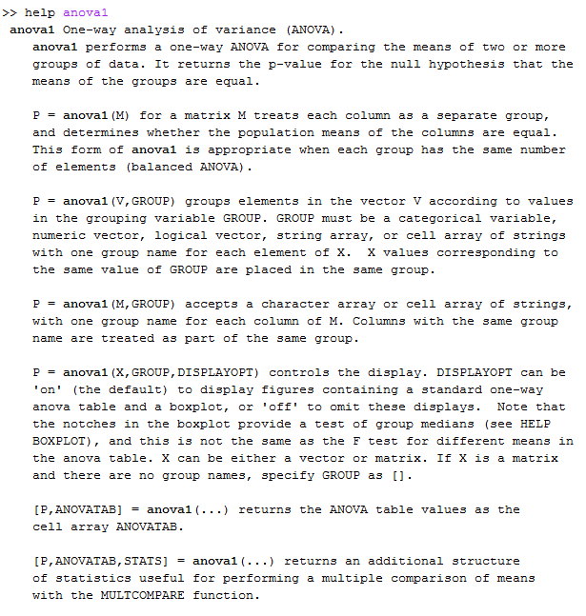
Calculating an ANOVA in MATLAB
p= anova1(X);
These use cases are the same and are for balanced ANOVA. The bottom one will label the bar graph
This use case can be used for both a balanced and unbalanced ANOVA

Slide 9
Assumptions of ANOVA
Independence: The samples are randomly and independently drawing from their respective populations
Normality (Parametric Method): Each population is normally distributed thus errors follow an normal distribution. (ANOVA is considered robust to volitions of normality)
Homoscedasticity: The variances of the groups are the same. (Most common violation, can use Welch’s ANOVA if so)

Slide 10
Checking for Normality of our data

Slide 11
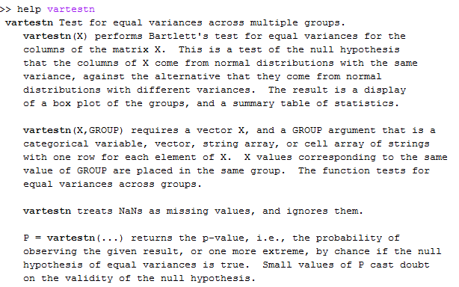
Testing Homoscedasticity: The variances of the groups are the same. vartestn
Similar calling to anova1 for balanced vs unbalanced data
pvar = .0171
We reject the null hypothesis with greater than 95% confidence (p < .05) that the variances disease durations amongst the clinical phenotypes are the same.

Slide 12
We have not meet two of the anova assumptions. What to do? Welch’s ANOVA or Kruskal-Wallis Testing
Welch’s ANOVA is a one-way ANOVA that doesn’t assume equal variances
Welch’s ANOVA isn’t built into Matlab. A Welch’s ANOVA code is published on MathWorks File Exchange It doesn’t do unbalanced data sets.
A Kruskal-Wallis test is a nonparametic version of a ANOVA

Slide 13
Kruskal-Wallis Test is nonparametric (no assumptions of normality or variance) Hypothesis Tested by Kruskal-Wallis
Null Hypothesis H₀: The mean rank of the members of the groups is the same
Research Hypothesis H₁ : The mean rank of the members of the groups is different
Stating the Results of an Kruskal-Wallis test
We reject the null hypothesis with p=.02 confidence that the mean rank of stock price change these stocks is the same.
We fail to reject the null hypothesis with greater than .95% confidence that the daily of stock price changes are the same.

Slide 14
Hypothesis Tested by Kruskal-Wallis Test Stated Another Way
Null Hypothesis H₀: The groups come from the same distribution
Research Hypothesis H₁ : The groups come from the different distributions
Stating the Results of an Kruskal-Wallis test
We reject the null hypothesis with p=.02 confidence that the mean rank of stock price change these stocks is the same.
We fail to reject the null hypothesis with greater than .95% confidence that the ran of stock price change is the same.

Slide 15
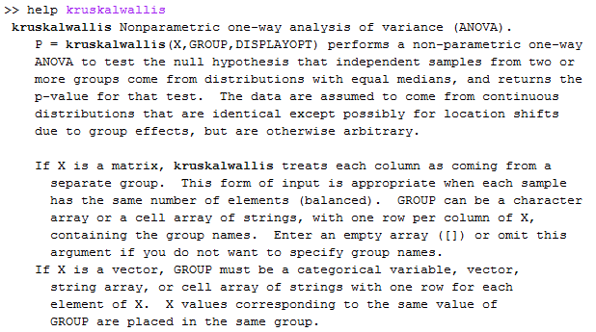
Performing a Kruskal-Wallis Test in Matlab >>kruskalwallis
Similar calling to anova1 for balanced vs unbalanced data
We reject the null hypothesis with greater than 95% confidence (p < .05) that the ranks of disease durations amongst the clinical phenotypes are the same.

Slide 16
Post Hoc Analysis: We got a significant p-value from ANOVA now what?
Go back and do t-tests to compare between subgroups. Problem: Repeated T-Tests increase the Type I Error Rate

Slide 17
We got a significant p-value from ANOVA now what? Post Hoc Analysis Methods to control for Type I Error
Bonferroni Adjustment: Lower the threshold for significance from .05 to .05/C where C is the # of comparisions.
Tukey’s Honestly Significant Difference Test (HSD Test)
Student Newman-Keul’s (SNK) Test
Duncan’s Multiple Range Test
Scheffe’s Test: Very Conservative, can be used for any contrast of interest
Dunnett’s Test: Used to compare several groups to a single control group

Slide 18
We got a significant p-value from ANOVA now what? Post Hoc Analysis Methods to control for Type I Error

Slide 19
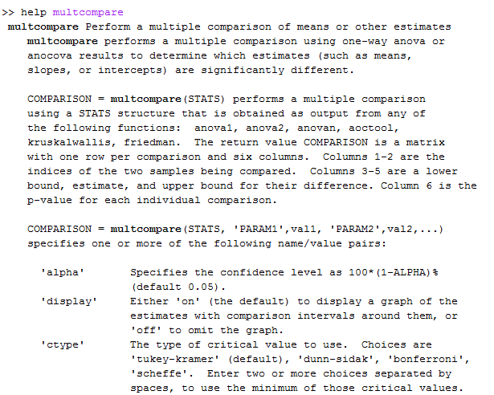
Post Hoc Comparisons in Matlab >>multcompare
Previous Slide

Slide 20
Matlab: Multcompare
Multcompare starts an interactive figure in which the user can determine if the first group is different from the remainder, and returns c.
For our example, c is (and has the form)
c =
1.0000 2.0000 -35.7693 -20.2988 -4.8284
1.0000 3.0000 -42.7647 -27.8782 -12.9918
2.0000 3.0000 -21.5441 -7.5794 6.3853
group1 group2 lower meandiff upper
meandiff is the difference in means
lower & upper are the 95% CIs on this difference
If the CI contains zero, accept H₀.
Notes:
p-values aren’t possible with multcompare. To get them you will need to perform the LSD (or other tests, to follow) with your own code.

Slide 21
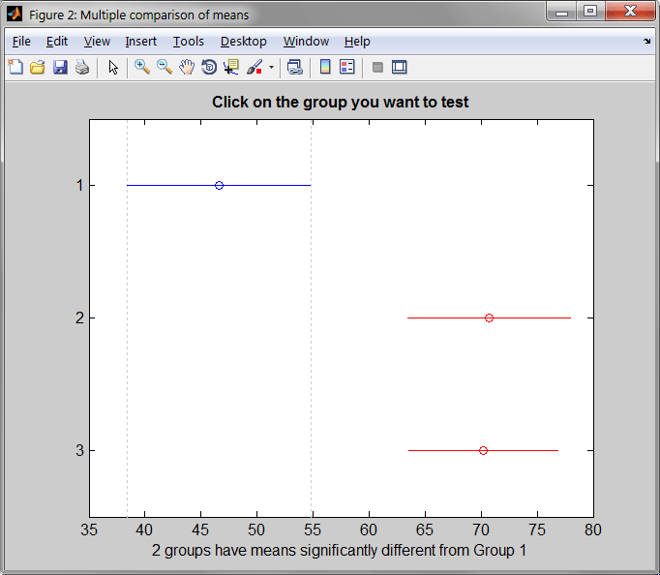
Matlab: Multicompare

Slide 22
Boneferroni Example
Let’s say we have ten groups to compare in Matlab
[p, table, stats] = anova1(X, groups);
We could then perform the multiple comparison
c = multcompare(stats, 'ctype', ...
'bonferroni');
which would adjust the α level (default 0.05) for multiple comparisons.

Slide 23
Comments on Post Hoc Analysis Methods If you throw enough darts at the board you are bound to hit it (Type I Error).
There is controversy over the use of post-hoc analysis. Some researchers use them all the time others never
Post-Hoc Analysis can inflate type II error rates.

Slide 24
2- (or n-) Way ANOVA
An extension of ANOVA to two or more independent variables (factors).
Consider number of years to cancer onset in a smoking study
As start with a 1×6 design:
non, passive, pipe, light, moderate, heavy
Can do 1 way ANOVA here.
Add sex of the smoker: M/F
Becomes a 2×6 design – variation due to degree of smoking and due to sex of the smoker – Can ask 2 way anova questions.
anova2 in or anovan matlab

Slide 25
2- (or n-) Way ANOVA There are 3 Hypotheses Under Test
H0: 1 – There is no mean difference in the number of years to cancer onset amongst smoking types (Same as 1 way anova) 2 – There is no mean difference in the number of years to cancer onset amongst the sexes (Same as 1 way anova) 3 – There is no interaction effect between the sexes, smoking and number of years to cancer onset. (Additional Hypothesis)

Slide 26
One-Way ANOVA Sums of Squares
In all variance analyses thus far we have considered deviations from the mean.
Now we have two levels of means:
Overall Mean y
Group Means y
Differences of interest become:
Individual Deviation:
Within Group Deviation:
Between Group Deviation:

Slide 27
One-Way ANOVA Sums of Squares
Deviations / Differences again are equal:
Overall Within Between
General Observations:
If within-group variability is large and between-group variability is small, the group means will likely be equal
If between-group variability is large and with-group variability is small, the group means will likely be different

Slide 28
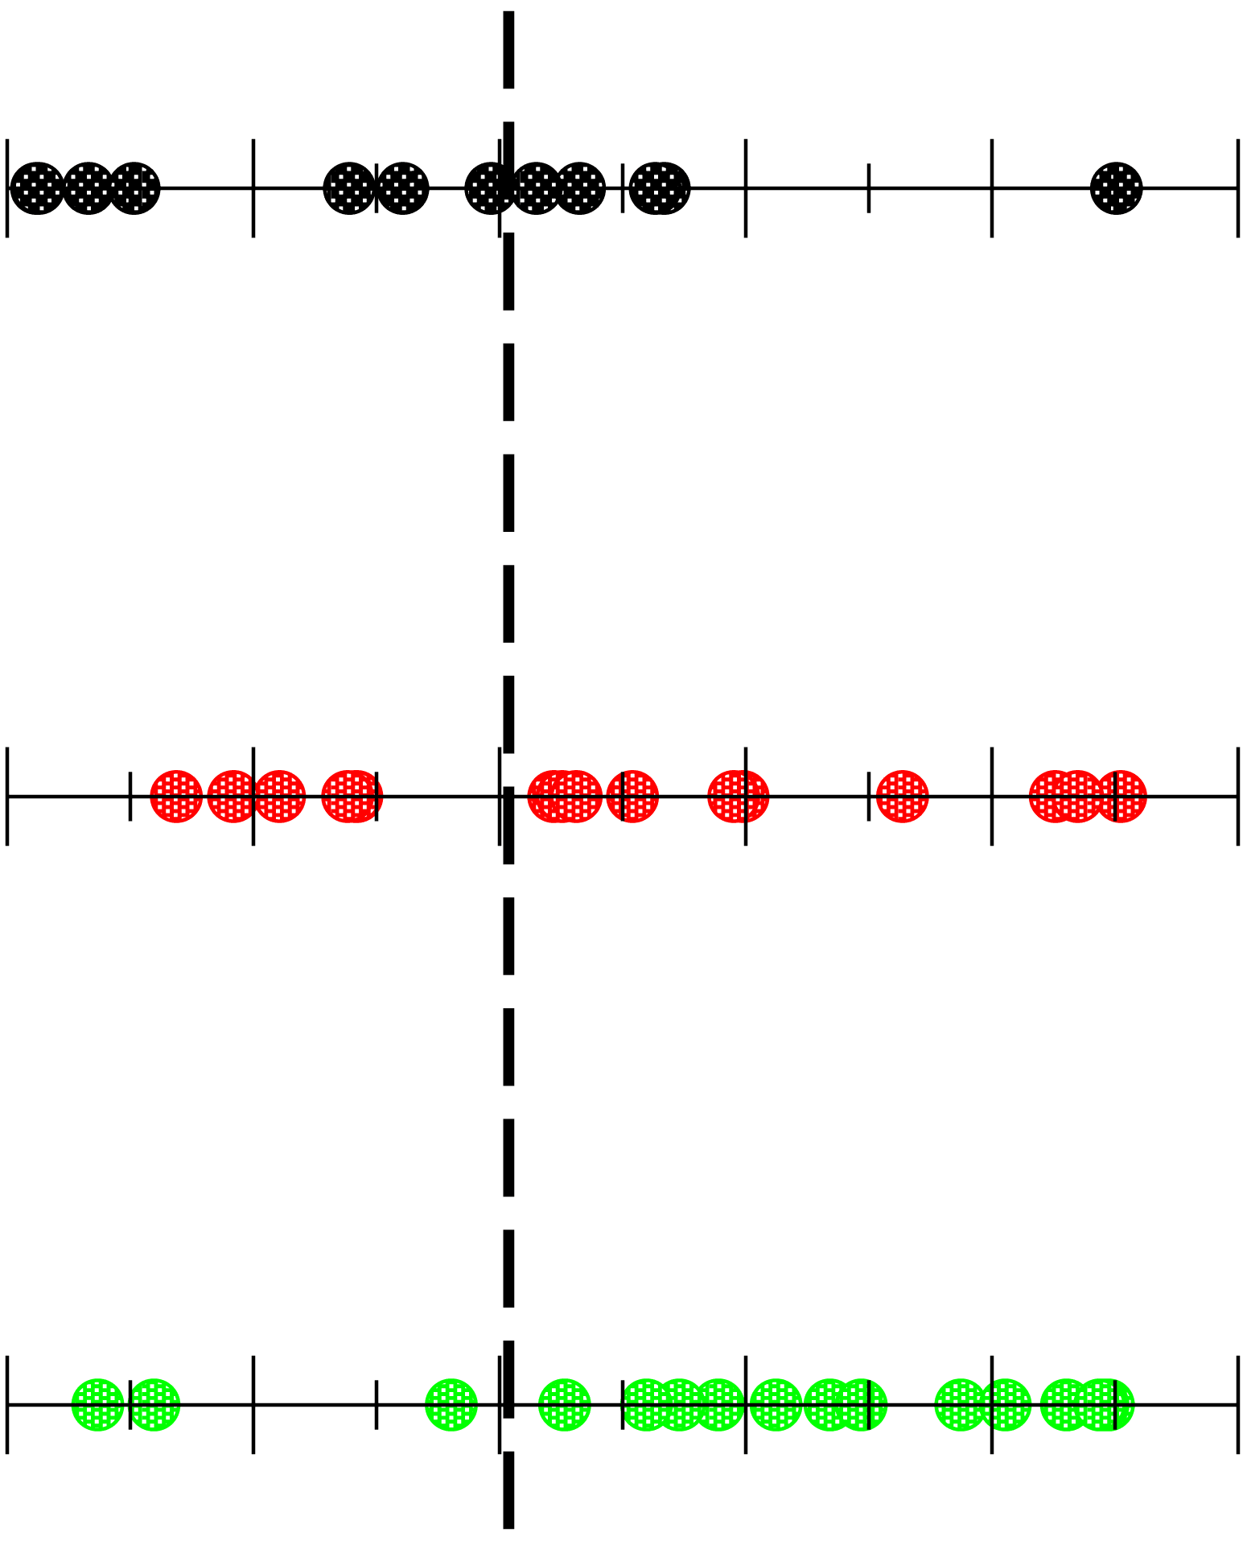
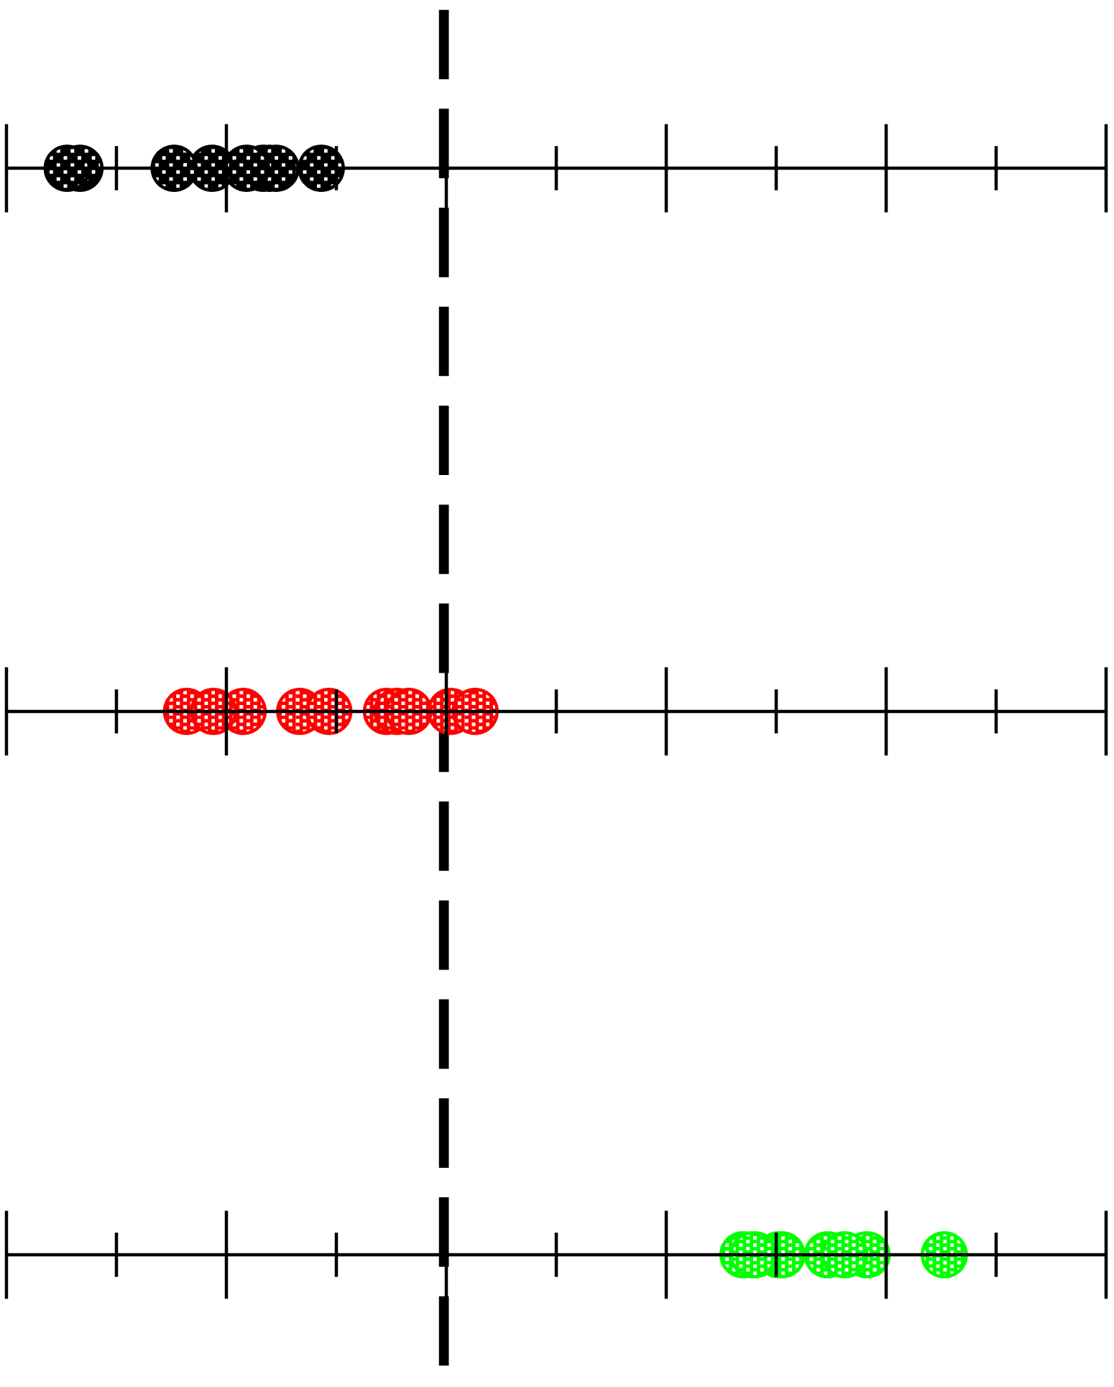
One-Way ANOVA Sums of Squares
Within Variability Large,
Between Variability Small:
Means Equal
Within Variability Small,
Between Variability Large:
Means Different

Slide 29
ANOVA and MLR Equivalence
Consider the multiple regression model
in which y is the outcome variable and β_{j} is 1 if the subject is in group (j + 1) and is 0 otherwise.
The x_{j} are known as dummy variables: they represent the k groups (the first group, the reference, has x_{j} = 0 for all j)

